Slide 1
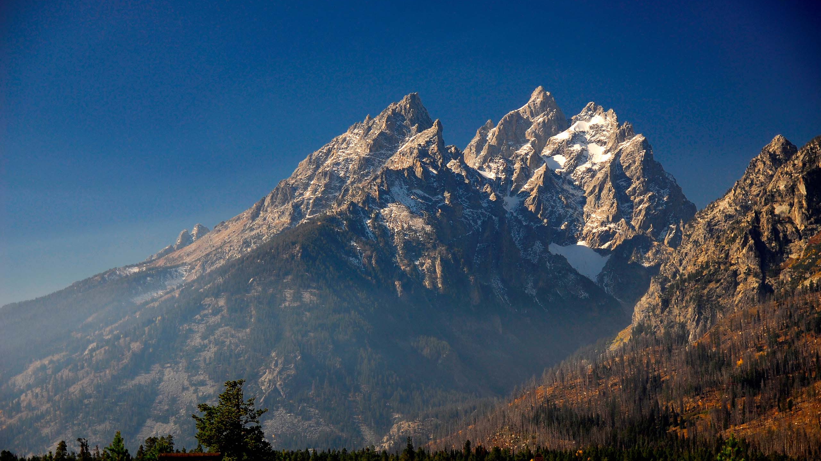
The LORD Alone is God
Psalm 115
Sunday, July 23, 2023

Slide 2
Psalm 115:1-8
1 Not to us, O LORD, not to us, But to Your name give glory Because of Your lovingkindness, because of Your truth. 2 Why should the nations say, "Where, now, is their God?" 3 But our God is in the heavens; He does whatever He pleases. 4 Their idols are silver and gold, The work of man's hands. 5 They have mouths, but they cannot speak; They have eyes, but they cannot see; 6 They have ears, but they cannot hear; They have noses, but they cannot smell; 7 They have hands, but they cannot feel; They have feet, but they cannot walk; They cannot make a sound with their throat. 8 Those who make them will become like them, Everyone who trusts in them.

Slide 3
Psalm 115:9-18
9 O Israel, trust in the LORD; He is their help and their shield. 10 O house of Aaron, trust in the LORD; He is their help and their shield. 11 You who fear the LORD, trust in the LORD; He is their help and their shield. 12 The LORD has been mindful of us; He will bless us; He will bless the house of Israel; He will bless the house of Aaron. 13 He will bless those who fear the LORD, The small together with the great. 14 May the LORD give you increase, You and your children. 15 May you be blessed of the LORD, Maker of heaven and earth. 16 The heavens are the heavens of the LORD, But the earth He has given to the sons of men. 17 The dead do not praise the LORD, Nor do any who go down into silence; 18 But as for us, we will bless the LORD From this time forth and forever. Praise the LORD!

Slide 4
What is the chief end of man?
Man’s chief end is to glorify God,
and to enjoy Him forever.

Slide 5
To Glorify God
…to glorify God is to make Him look good, to reveal Him by word and deed, as He truly is.

Slide 6
The Big Idea
If God is to be rightly glorified, we must forsake all idolatry, must look to God for all our needs, and must bless the Lord all our days.

Slide 7
Psalm 115 Outline
Yahweh alone is to be glorified (1-3)
Yahweh alone is to be worshipped (4-8)
Yahweh alone is to be trusted (9-15)
Yahweh alone is to be praised forever (16-18)

Slide 8
Yahweh alone is to be glorified ⁽¹⁻³⁾
1 Not to us, O LORD, not to us, But to Your name give glory Because of Your lovingkindness, because of Your truth. 2 Why should the nations say, "Where, now, is their God?" 3 But our God is in the heavens; He does whatever He pleases.
Do not take God’s glory for yourself ^{(1a)}
I am the LORD, that is My name; I will not give my glory to another, nor My praise to graven images. (Isaiah 42:8)
For My own sake, for My own sake, I will act; for how can My name be profaned? And My glory I will not give to another. (Isaiah 48:11)

Slide 9
1 Corinthians 4:7
What do you have that you did not receive? And if you did receive it, why do you boast as if you had not received it?

Slide 10
Charles Spurgeon
If you meet with a system of theology which magnifies man, flee from it as far as you can…. Here is a test for you to apply, and by it you may tell whether a thing is true or not. Does it glorify God? Then, accept it. If it does not, if it glorifies man—puts human will, human ability, human merit, into the place of the mercy and the grace of God—away with it, for it is not food fit for your souls to feed upon.

Slide 11
Yahweh alone is to be glorified ⁽¹⁻³⁾
1 Not to us, O LORD, not to us, But to Your name give glory Because of Your lovingkindness, because of Your truth. 2 Why should the nations say, "Where, now, is their God?" 3 But our God is in the heavens; He does whatever He pleases.
Do not take God’s glory for yourself ^{(1a)}
Proclaim the lovingkindness (mercy) and truth (faithfulness) of the LORD ^{(1b)}

Slide 12
Yahweh alone is to be glorified ⁽¹⁻³⁾
1 Not to us, O LORD, not to us, But to Your name give glory Because of Your lovingkindness, because of Your truth. 2 Why should the nations say, "Where, now, is their God?" 3 But our God is in the heavens; He does whatever He pleases.
Do not take God’s glory for yourself ^{(1a)}
Proclaim the lovingkindness and truth of the LORD ^{(1b)}
Do nothing that would taint God’s glory among unbelievers ⁽²⁾

Slide 13
Yahweh alone is to be glorified ⁽¹⁻³⁾
1 Not to us, O LORD, not to us, But to Your name give glory Because of Your lovingkindness, because of Your truth. 2 Why should the nations say, "Where, now, is their God?" 3 But our God is in the heavens; He does whatever He pleases.
Do not take God’s glory for yourself ^{(1a)}
Proclaim the lovingkindness and truth of the LORD ^{(1b)}
Do nothing that would taint God’s glory among unbelievers ⁽²⁾
Ponder the absolute sovereignty of God ⁽³⁾

Slide 14
Daniel 4:25
But He does according to His will in the host of heaven and among the inhabitants of earth; and no one can ward off His hand or say to Him, ‘What have You done?’
~King Nebuchadnezzar of Babylon

Slide 15
Job 42:2
I know that You can do all things, and that no purpose of Yours can be thwarted.
Do you believe this? Do you live in view of this?

Slide 16
Isaiah 46:9-10
9 For I am God, and there is no other; I am God, and there is no one like Me, 10 declaring the end from the beginning, and from ancient times things which have not been done, saying, ‘My purpose will be established, and I will accomplish all My good pleasure.’”

Slide 17
Yahweh alone is to be Worshipped ⁽⁴⁻⁸⁾
4 Their idols are silver and gold, The work of man's hands. 5 They have mouths, but they cannot speak; They have eyes, but they cannot see; 6 They have ears, but they cannot hear; They have noses, but they cannot smell; 7 They have hands, but they cannot feel; They have feet, but they cannot walk; They cannot make a sound with their throat. 8 Those who make them will become like them, Everyone who trusts in them.
Idols are the work of man ⁽⁴⁾
Idols are lifeless ⁽⁵⁻⁸⁾

Slide 18
Yahweh alone is to be trusted ⁽⁹⁻¹⁵⁾
9 O Israel, trust in the LORD; He is their help and their shield. 10 O house of Aaron, trust in the LORD; He is their help and their shield. 11 You who fear the LORD, trust in the LORD; He is their help and their shield. 12 The LORD has been mindful of us; He will bless us; He will bless the house of Israel; He will bless the house of Aaron. 13 He will bless those who fear the LORD, The small together with the great. 14 May the LORD give you increase, You and your children. 15 May you be blessed of the LORD, Maker of heaven and earth.
Trust in the LORD for help ⁽⁹⁻¹¹⁾
Trust the LORD for blessing ⁽¹²⁻¹⁵⁾

Slide 19
Yahweh alone is to be praised forever ⁽¹⁶⁻¹⁸⁾
16 The heavens are the heavens of the LORD, But the earth He has given to the sons of men. 17 The dead do not praise the LORD, Nor do any who go down into silence; 18 But as for us, we will bless the LORD From this time forth and forever. Praise the LORD!
Praise the LORD for His supremacy ⁽¹⁶⁾
Praise the LORD as you are able ⁽¹⁷⁻¹⁸⁾

Slide 20
Charles Spurgeon
Though the dead cannot, the wicked will not and the careless do not praise God, yet we will shout ‘Hallelujah’ for ever and ever.” One way in which we exercise our dominion on earth is to praise the Lord all our days.

Slide 21
The Big Idea
If God is to be rightly glorified, we must forsake all idolatry, must look to God for all our needs, and must bless the Lord all our days.

Slide 22
The LORD Alone is God
Psalm 115
Sunday, July 23, 2023

